Slide 1
MENTORNESS INTERNSHIP BY MD ARSALAN
ANALYSIS OF FOOD AND BEVERAGES INDUSTRY SURVEY DATA (TASK-3)

Slide 2
PROJECT OVERVIEW
THE OBJECTIVE OF THIS PROJECT IS TO ANALYZE SURVEY RESPONSES FROM AND BEVERAGE INDUSTRY TO GAIN INSIGHTS INTO CONSUMER BEHAVIOUR PREFRENCES AND PERCEPTIONS. THE ANALYSIS WILL HELP IDENTIFY KEY TRENDS, UNDERSTAND BRAND PERCEPTION AND EXPLORE POTENTIAL AREA FOR IMPROVEMENT.

Slide 3
DATASET INFORMATION
Fact Table: fact_survey_responses
• Response_ID: Unique identifier for each survey response.
• Respondent_ID: Unique identifier for each respondent.
• Consume_frequency: Frequency of consumption of food and beverage products.
• Consume_time: Typical time when the products are consumed.
• Consume_reason: Reasonsfor consuming the products.
• Heard_before: Whether the respondent has heard of the product before.
• Brand_perception: Respondent's perception of the brand.
• General_perception: Overall perception of the food and beverage industry.
• Tried_before: Whether the respondent has tried the product before.
• Taste_experience: Respondent's experience with the taste of the product.
• Reasons_preventing_trying: Reasons preventing respondentsfrom trying the product.
• Current_brands: Brands currently consumed by the respondent.
• Reasons_for_choosing_brands: Reasonsfor choosing specific brands.
• Improvements_desired: Improvements desired in products.
• Ingredients_expected: Expected ingredients in products.
• Health_concerns: Health concernsrelated to products.
• Interest_in_natural_or_organic: Interest in natural or organic products.
• Marketing_channels: Preferred marketing channels for product information.
• Packaging_preference: Preferencesfor product packaging.
• Limited_edition_packaging: Interest in limited edition packaging.
• Price_range: Preferred price range for products.
• Purchase_location: Typical locations where products are purchased.
• Typical_consumption_situations: Common situationsin which products are consumed.

Slide 4
DIMENSION TABLE: DIM RESPONDENT
• Respondent_ID: Unique identifier for each respondent.
• Name: Name of the respondent.
• Age: Age of the respondent.
• Gender: Gender of the respondent.
• City_ID: Identifier linking the respondent to a city.

Slide 5
DIMENSION TABLE: DIM CITIES
• City_ID: Unique identifier for each city.
• City: Name of the city.
• Tier: Tier classification of the city (e.g., Tier 1, Tier 2).

Slide 6
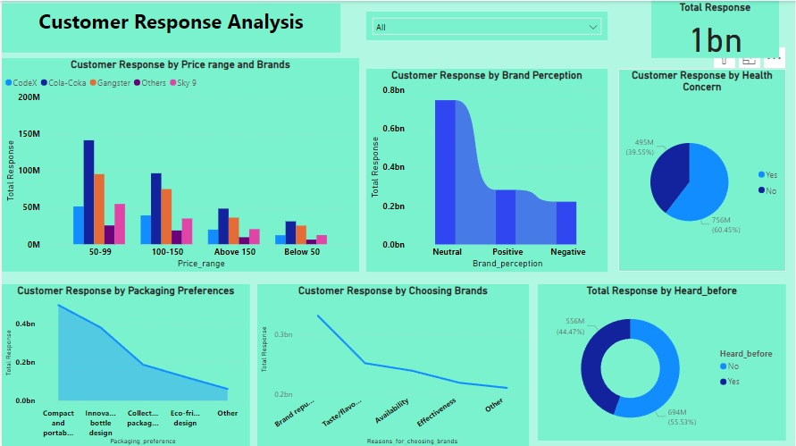

Slide 7
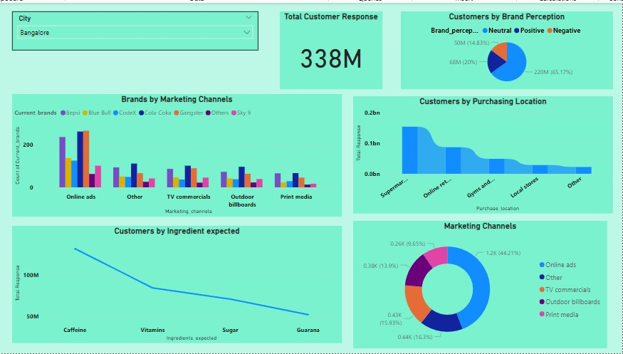

Slide 8
CONCLUSION
Total customer response is 86%.
Customer brand perception is neutral.
60% customers are health concern and 40% customers are not health concern.
Most customers choose brands because of its reputation.
Customers packaging preferences is Compact and Portable Design.
Customers prefered Cola-Coka over price range.
Top three brands preferred by customers are Cola-Coka,Bepsi and CodeX.
Most customers buy their brands from Supermarket.
In different marketing channels Cola-Coka has highest number of marketing channels from others brands.
Bangalore has highest number of response of 338M.
Mumbai has maximum marketing channels from TV commercials.
Kolkata , Chennai, and Bangalore has maximum marketing channels from Online Ads.
Bangalore has highest number of customers that buy from Supermarkets

